Slide 1
GLOBOX
Launch or Not - Food & Drinks
banner in webpage

Slide 2
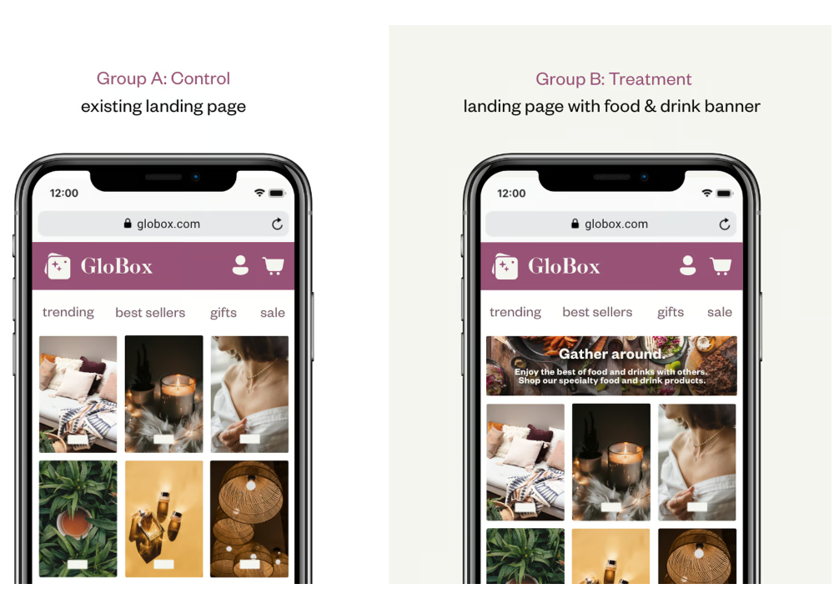


Experiment Goal
To compare & identify the webpage with banner or webpage without banner, which performs better to increase the revenue.
Group A (Control) : 24,343 users
Total users: 48943
Group B (Treatment) : 24,600 users

Slide 3



Time duration & Key Success Metrics
Duration: 25-Jan-2023 To 6-Feb-2023 (2 Weeks)
Conversion Rate measure
Average Amount Spent measure

Slide 4
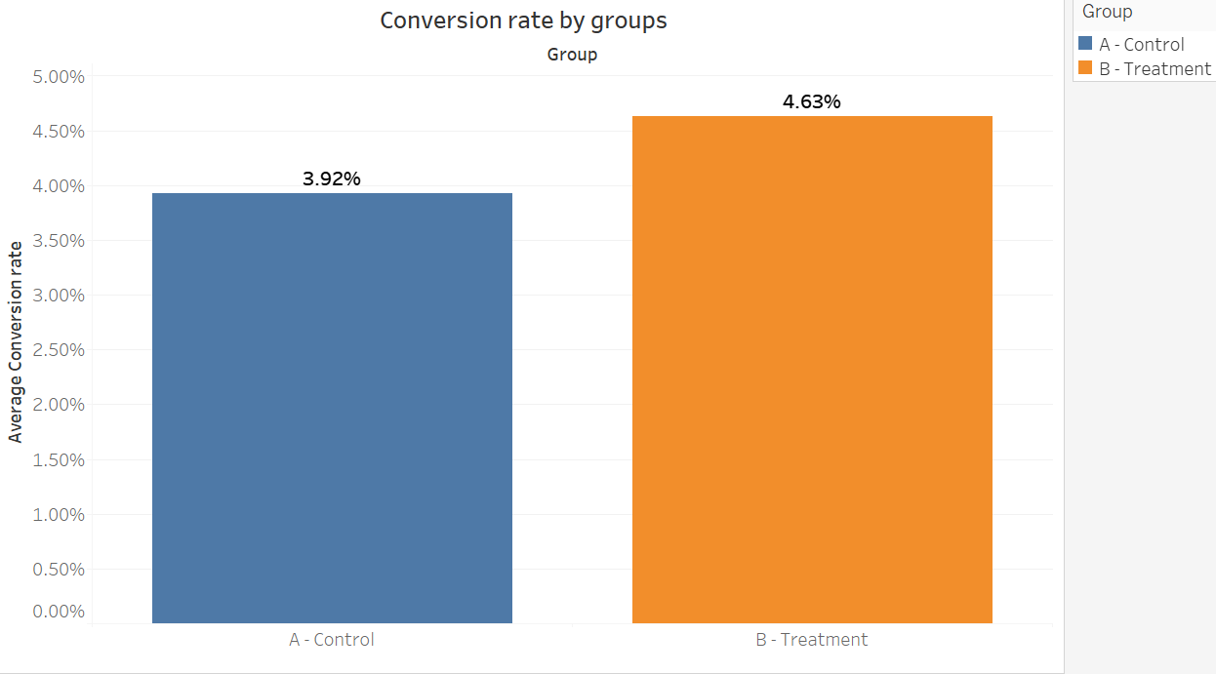
Improvement in Conversion rate
There is a strong statistical evidence that proved conversion rate was different between the groups.
Significant improvement in treatment group.
Number of users purchased
Control : 955
Treatment: 1139

Slide 5
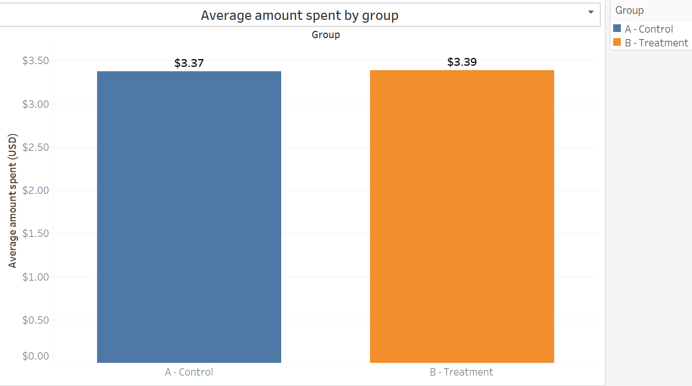
No Improvement in Average amount spend
There is no strong statistical evidence that can prove there is a different in average amount spent between the groups.
No increase in revenue.
Total Spent (USD)
Control : $82,146
Treatment: $83,415

Slide 6
Recommendation: Iterate the test
We didn’t see enough improvement in Average amount spent metric.
How ever there is an improvement in conversion rate, but that does not lead us to increase in revenue.
In order to bring more visuality, why average amount spend does not increase even though conversion rate increased.
I recommend to iterate the experiment for longer duration (6 weeks) with large number of users which can provide us more reliable results.

Slide 7
Thank You!

